Slide 1
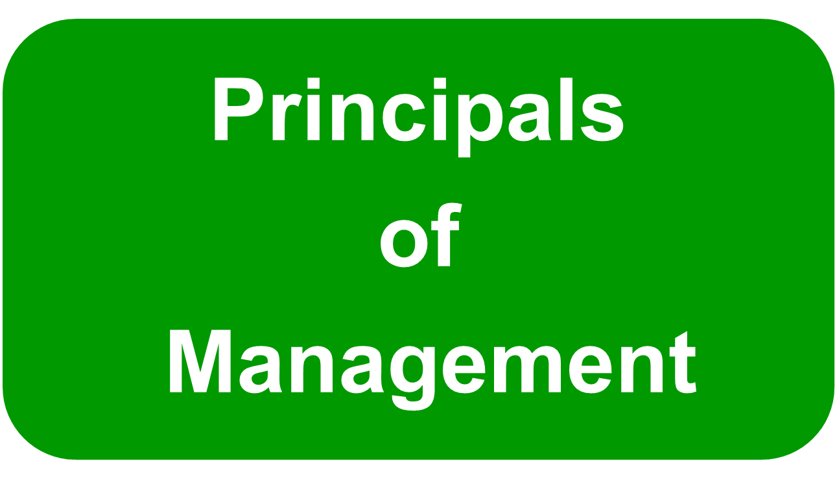


Slide 2
© 2007 Prentice Hall, Inc. All rights reserved.
1–<number>

Slide 3
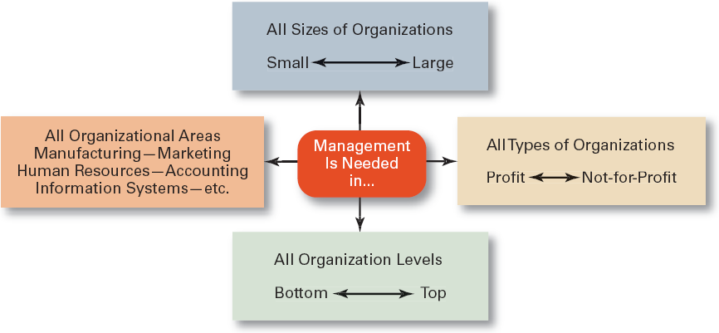
© 2007 Prentice Hall, Inc. All rights reserved.
1–<number>

Slide 4
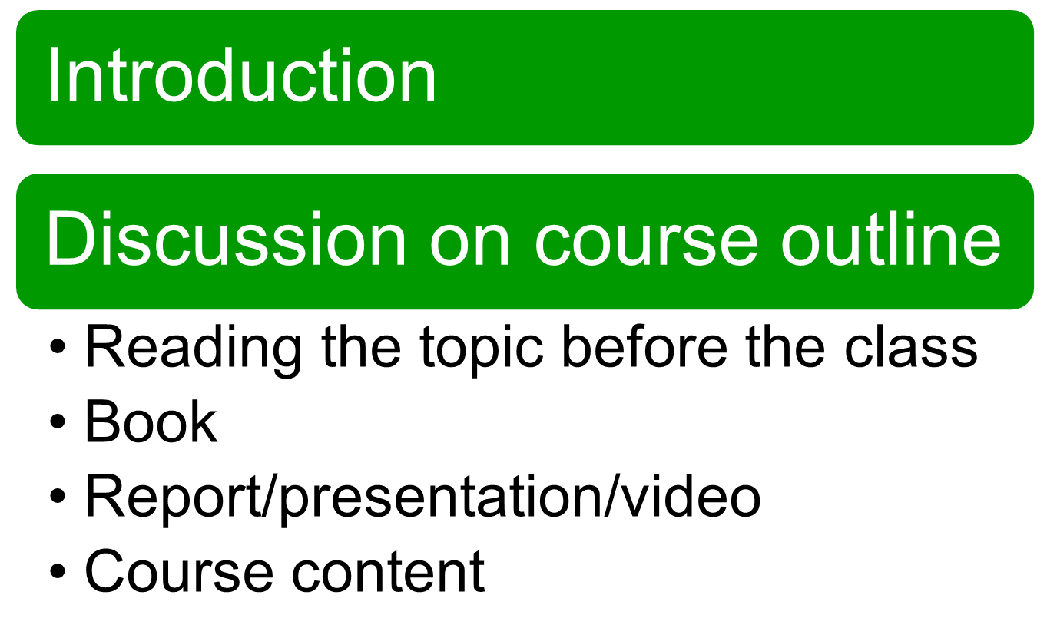

Slide 5
Introduction to Management and Organizations
Chapter
1

Slide 6

Manager
  coordinates
  oversees the work of other people
© 2007 Prentice Hall, Inc. All rights reserved.
1–<number>

Slide 7
First-line Managers
  Individuals who manage the work of non-managerial employees.
Middle Managers
  Individuals who manage the work of first-line managers.
Top Managers
  Individuals who are responsible for making organization-wide decisions and establishing plans and goals that affect the entire organization.
© 2007 Prentice Hall, Inc. All rights reserved.
1–<number>

Slide 8
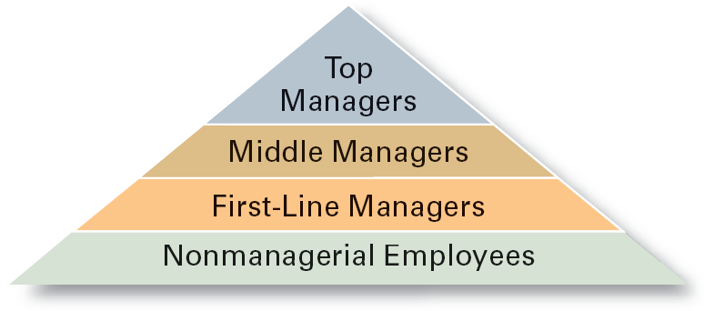
Exhibit 1–1 Managerial Levels
© 2007 Prentice Hall, Inc. All rights reserved.
1–<number>

Slide 9

What Is Management?
Managerial Concerns
  Efficiency
    “Doing things right”
      Getting the most output for the least inputs
  Effectiveness
    “Doing the right things”
      Attaining organizational goals
© 2007 Prentice Hall, Inc. All rights reserved.
1–<number>

Slide 10
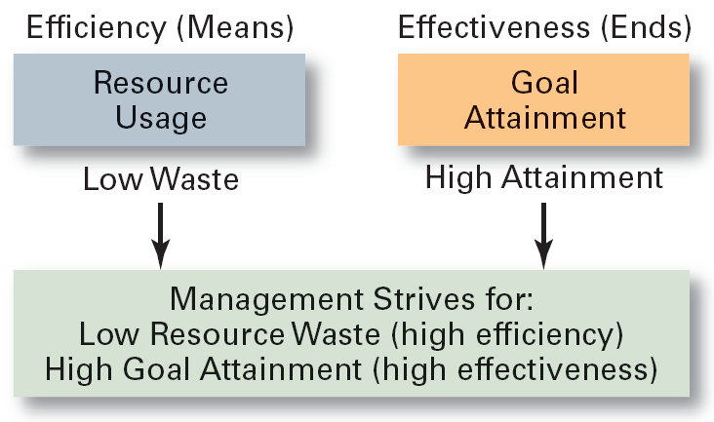
Exhibit 1–2 Effectiveness and Efficiency in Management
© 2007 Prentice Hall, Inc. All rights reserved.
1–<number>

Slide 11
  Planning
    Defining goals, establishing strategies to achieve goals, developing plans to integrate and coordinate activities.
  Organizing
    Arranging and structuring work to accomplish organizational goals.
  Leading
    Working with and through people to accomplish goals.
  Controlling
    Monitoring, comparing, and correcting work.
© 2007 Prentice Hall, Inc. All rights reserved.
1–<number>

Slide 12
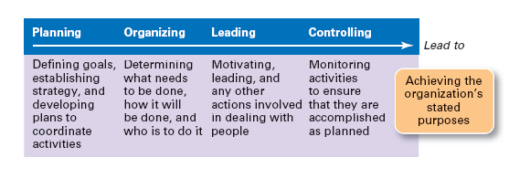
Exhibit 1–3 Management Functions
© 2007 Prentice Hall, Inc. All rights reserved.
1–<number>

Slide 13

  Task: read on these roles for next week
  Interpersonal roles
    Figurehead, leader, liaison
  Informational roles
    Monitor, disseminator, spokesperson
  Decisional roles
    Disturbance handler, resource allocator, negotiator
© 2007 Prentice Hall, Inc. All rights reserved.
1–<number>

Slide 14
Skills Approach
  Technical skills
    Knowledge and proficiency in a specific field
  Human skills
    The ability to work well with other people
  Conceptual skills
    The ability to think and conceptualize about abstract and complex situations concerning the organization
© 2007 Prentice Hall, Inc. All rights reserved.
1–<number>

Slide 15
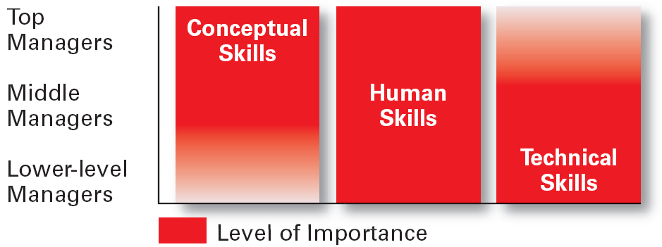
Exhibit 1–5 Skills Needed at Different Management Levels
© 2007 Prentice Hall, Inc. All rights reserved.
1–<number>

Slide 16
The Increasing Importance of Customers
Innovation
Competition
© 2007 Prentice Hall, Inc. All rights reserved.
1–<number>

Slide 17
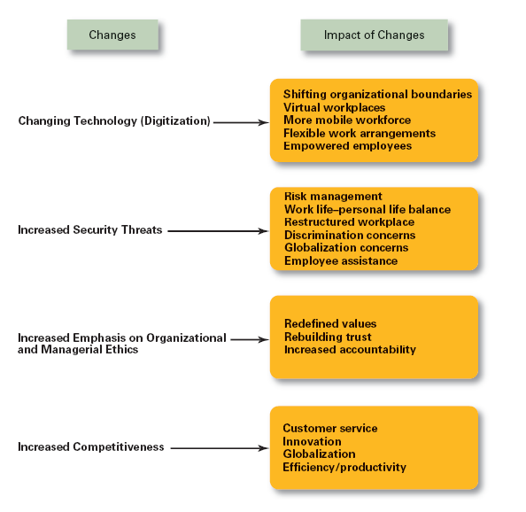
Exhibit 1–8
Changes Impacting the Manager’s Job
© 2007 Prentice Hall, Inc. All rights reserved.
1–<number>

Slide 18
An Organization Defined
  A deliberate arrangement of people to accomplish some specific purpose (that individuals independently could not accomplish alone).
Common Characteristics of Organizations
  Have a distinct purpose (goal)
  Composed of people
  Have a deliberate structure
© 2007 Prentice Hall, Inc. All rights reserved.
1–<number>

Slide 19
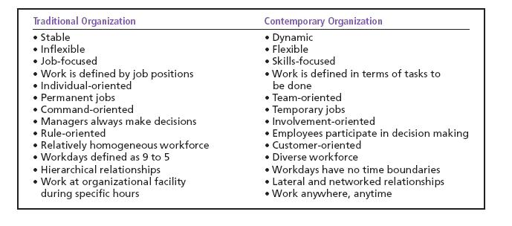
Exhibit 1–10 The Changing Organization
© 2007 Prentice Hall, Inc. All rights reserved.
1–<number>

Slide 20
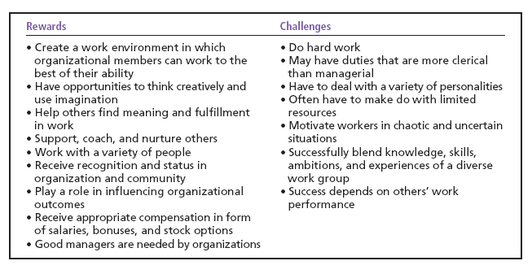
Exhibit 1–12 Rewards and Challenges of Being A Manager
© 2007 Prentice Hall, Inc. All rights reserved.
1–<number>

Slide 21
Next Class - Project
Group Members names
Group number
Submission of Organization Name
© 2007 Prentice Hall, Inc. All rights reserved.
1–<number>

